Slide 1


Discrete LTI
Discrete LTI Systems
carmine.clemente@strath.ac.uk

Slide 2
Discrete Systems
Discrete System
$$x[n]$$
$$y[n]$$
Black Box Representation of a Discrete System

Slide 3
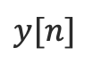
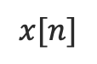
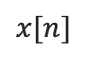
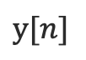
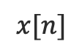
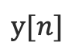
Discrete Systems
Systems can be cascaded in series or in parallel or both:
Parallel
Series
System 1
$$x[n]$$
System 2
$$y[n]$$
$$x[n]$$
$$y[n]$$
System 1
System 2
Combination of Series and Parallel
System 2
$$x[n]$$
System 4
$$y[n]$$
System 1
System 3

Slide 4
Systems Classification
It is useful to classify systems in a number of categories;
Our aim is to identify a particular class called Linear-Time Invariant (LTI) systems;
In the following we will use $x_{1}\left[n\right], x_{2}[n]$ to represent inputs to discrete systems and $y_{1}\left[n\right], y_{2}[n]$to represent the corresponding outputs.
$$x_{1}[n]$$
produces
$$y_{1}[n]$$

Slide 5
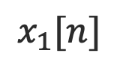
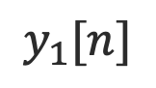
Causality
We defined a causal signal as a signal that had zero value before time zero;
Similarly we can define a causal system. A causal system is a system with NO output without an input;
Let us consider a system whose input is a causal signal $x_{1}\left[n\right]:$
if $y_{1}[n] = 0$for $n<0$then the system is causal.
ALL physically realizable systems are causal, non causal systems exists but require non-real time processing (i.e. play music backwards)
$$x_{1}[n]$$
produces
$$y_{1}[n]$$

Slide 6
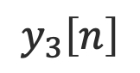

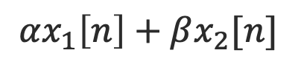
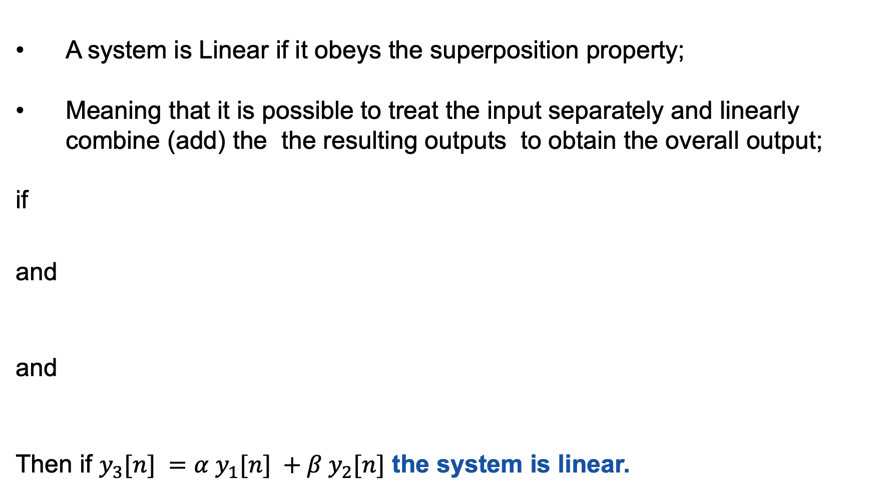
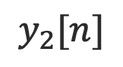
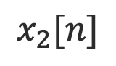
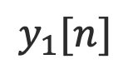
Linearity
A system is Linear if it obeys the superposition property;
Meaning that it is possible to treat the input separately and linearly combine (add) the the resulting outputs to obtain the overall output;
if
and
and
Then if $y_{3}[n] =α y_{1}[n] +β y_{2}[n]$ the system is linear.
$$x_{1}[n]$$
produces
$$y_{1}[n]$$
$$x_{2}[n]$$
produces
$$y_{2}[n]$$
$$αx_{1}\left[n\right]+βx_{2}[n]$$
produces
$$y_{3}\left[n\right]$$

Slide 7
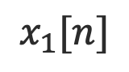
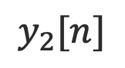
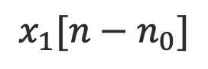

Time-Invariance
if
and
For the system to be Time-Invariant it is required that
$y_{2}[n] = y_{1}[n−n_{0}]$
Where $n_{0}$is a constant time shift.
$$x_{1}[n]$$
produces
$$y_{1}[n]$$
$$x_{1}[n−n_{0}]$$
produces
$$y_{2}[n]$$

Slide 8
LTI systems
If a discrete system is simultaneously classed as Linear and Time-Invariant then it is termed as LTI discrete system;
This course will have most of its interest on this type of systems;
Assuming that a system is LTI is not a very restrictive assumption (many real world problems can be modelled as LTI) and will allow us to generalise our system analyses.

Slide 9
Stable and Memoryless Systems
A system is stable (does not tend to infinity) if it responds with bounded outputs to bounded inputs (BIBO);
Any system whose output depends only on the current input is memoryless;
All systems with a storage component (delay elements) are systems with memory;

Slide 10
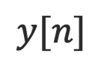
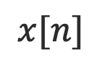
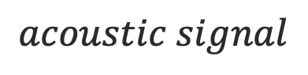
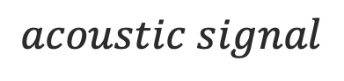
Describing Discrete Systems
The black box representation is useful in representing the systems but proper formulation(s) is needed to describe a system;
Room
$$x[n]$$
$$y[n]$$
$$acoustic signal$$
$$acoustic signal$$
$$y\left[n\right]=a_{0}x\left[n−n_{0}\right]+a_{1}x\left[n−n_{1}\right]+a_{2}x[n−n_{2}]$$
Direct path
1st Reflected path
2nd Reflected path

Slide 11
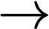
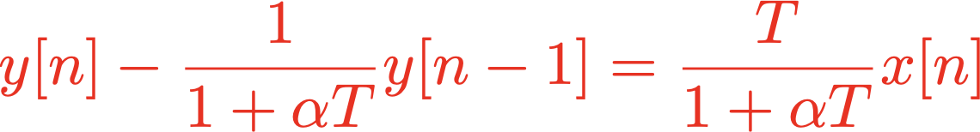
Describing Discrete Systems
Example – Linear Differential Equation
Let us consider a 1st order linear differential equation
If we discretize it with $y(nT) = y[n]$and $x(nT) =x\left[n\right]$ and
then
1st order linear difference Eq with constant coefficients

Slide 12
Describing Discrete Systems
In the case of discrete systems the ‘shift’ operator takes the place of the differential operator and the describing equations for LTI discrete systems are known as Linear Difference Equations with Constant Coefficients;
These comprise simple weighted shifted versions of inputs and output discrete signals;
It is useful to introduce an additional operator to better represent the ‘shift’.

Slide 13
The ‘z’ Operator
The z-operator, or shift operator, is applicable to any discrete function so that
$z[n]$ operates on $y[n]$ to produce $y[n+1]$, similarly:

Slide 14
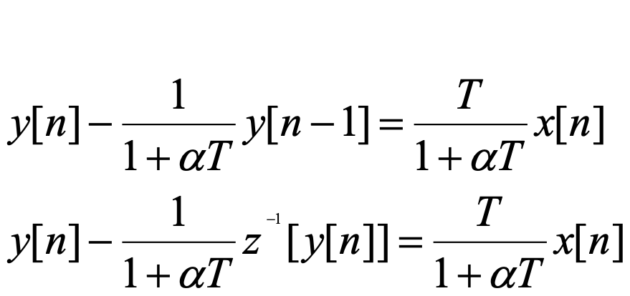
The ‘z’ Operator
Example – Acoustic room system
$$y\left[n\right]=a_{0}x\left[n−n_{0}\right]+a_{1}x\left[n−n_{1}\right]+a_{2}x[n−n_{2}]$$
Using the z operator becomes
Example – Linear Differential Equation
Using the z operator becomes

Slide 15
The ‘z’ Operator
Example – Monthly balance
Write a first-order difference equation to calculate the monthly balance of a £100,000 loan at 1% per month interest assuming monthly payments of £1200 (from month 0).
$y[n]$: the monthly balance at month n
Given: $y[−1]= 100,000$(initial condition)
$x[n] = −1200u[n]$amount paid back each month
This is a 1st order difference equation with constant coefficients

Slide 16
Linear Difference Equation with Constant Coefficients
We can now generalise the concept for the N-th order LTI discrete system that can be described by the following N-th order difference equation with constant coefficients.

Slide 17
Linear Difference Equation with Constant Coefficients
Linear Combination of the output up to and including the N-th order difference
Linear Combination of the input up to and including the M-th order difference
=

Slide 18
Discrete LTI
Responses from DSP systems
carmine.clemente@strath.ac.uk

Slide 19
Characterizing Responses from LTI Systems
Previously we demonstrated how LTI discrete systems may be described using linear difference equations with constant coefficients:
We shall now investigate the characteristics of these describing equations in an effort to establish the general responses obtained from the LTI systems.

Slide 20
Characterizing Responses from LTI Systems
We can see this part as the ‘forcing function’ (i.e. the stimulus or input that causes a particular component of the output).
One such solution to the difference equation is obtained by assuming zero initial conditions (no initial energy stored in the system).
This particular solution is termed the Zero State Response $y_{zsr}[n]$.

Slide 21
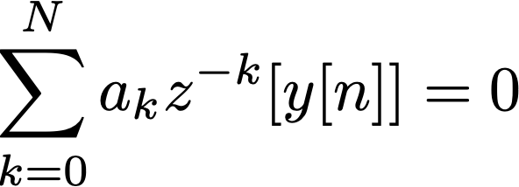
Characterizing Responses from LTI Systems
If we set the right hand side of the equation to 0, we obtain the Homogeneous Difference Equation (Response of System when NO input is applied).
The solution of the Homogeneous equation will provide us with the component of the output that occurs due to the system itself and is not a function of the input (i.e. the homogeneous solution or Zero Input Response $y_{zir}[n]$).

Slide 22
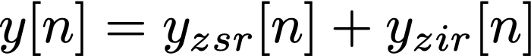
Characterizing Responses from LTI Systems
In general the solution to the Nth order difference equation may be written as:
and can be graphically visualized as:
$$x[n]$$
System with Zero Initial Conditions
$$y_{zsr}[n]$$
0 input
System with Initial Condition
$$y_{zir}[n]$$

Slide 23

Characterizing Responses from LTI Systems
$$x[n]$$
System with Zero Initial Conditions
$$y_{zsr}[n]$$
0 input
System with Initial Condition
$$y_{zir}[n]$$
$ytr[n]$is the transient component of the output (the component that decays to zero as time increases);
$yss[n]$is the steady state component of the output (the component that does not decay to zero as time increases);
In general the zero state response and the zero input response can contain steady state and transient components.

Slide 24
Discrete Systems: The Characteristic Equation
From the Homogeneous Equations we now are in a position to define the characteristic equation (CE) for LTI discrete systems as:
OR
The Characteristic Equation (CE)

Slide 25
Discrete Systems: The Characteristic Equation
The characteristic equation comprises a polynomial of order N.
This polynomial has N roots (some possibly complex).
The values of these roots dictate (i.e. characterise) the behaviour of the system. They determine the type of output we will get from the system (either exponential, sinusoidal, damped sinusoidal etc.) due to general inputs as we shall see later.

Slide 26

Impulse response
We now define some of the more important responses that we shall be interested in establishing from LTI systems.
The impulse response is the response of the system when the input is a unit impulse.
Unit impulse
Impulse response
n
n
Discrete System
$$x[n]$$
$$y[n]$$

Slide 27
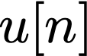



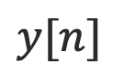
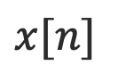
Step Response
The step response is the response of the system when the input is a unit step;
In the step response is possible to see the transient and the steady state components.
Unit step
Step response
n
n
Discrete System
$$x[n]$$
$$y[n]$$

Slide 28
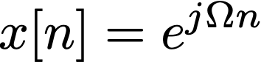
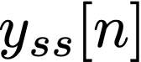
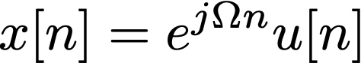
Frequency Responses
The frequency response of systems due to a sinusoidal excitation that has been present for all time is viewed as:
Present all time
Discrete System
Steady State Frequency Response
Switches on at n=0
Discrete System

Slide 29
Convolution sum
We have now studied input and output signals of systems;
We have learned how describe LTI discrete systems;
We have defined various important responses from systems;
Now we must establish a relationship between the output for a general input for LTI systems;
This is called convolution and is introduced here for LTI discrete systems where is called the convolution sum.

Slide 30
Convolution sum
The response of any LTI system to a unit impulse produces the impulse response $h\left[n\right].$
Because any general input signal can be written as a sum of weighted, shifted impulses then, using the property of superposition associated with LTI systems, we can write the output due to any general input as a sum of weighted shifted impulse responses.
This leads to the definition of the convolution sum operator for discrete LTI systems.
LTI - Discrete System
Generic input written as sum of weighted shifted impulses

Slide 31
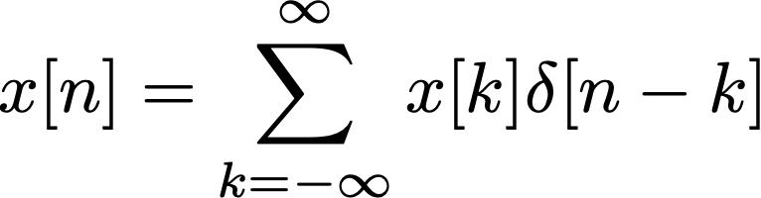
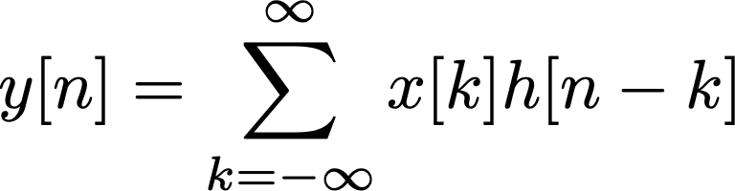
Convolution sum
In general we can see that
$$x\left[−2\right]δ[n+2]$$
$$x\left[−2\right]h[n+2]$$
$$x\left[−1\right]δ[n+1]$$
$$x\left[−1\right]h[n+1]$$
$$Σ$$
LTI - Discrete System
$$Σ$$
$$x\left[0\right]δ[n]$$
$$x\left[0\right]h[n]$$
$$x\left[1\right]δ[n−1]$$
$$x\left[1\right]h[n−1]$$
$$x\left[2\right]δ[n−2]$$
$$x\left[2\right]h[n−2]$$
Convolution SUM

Slide 32

Convolution sum
We can formalize the convolution sum for discrete LTI systems as
$$x[n]$$
h[n]
$$y[n]$$

Slide 33
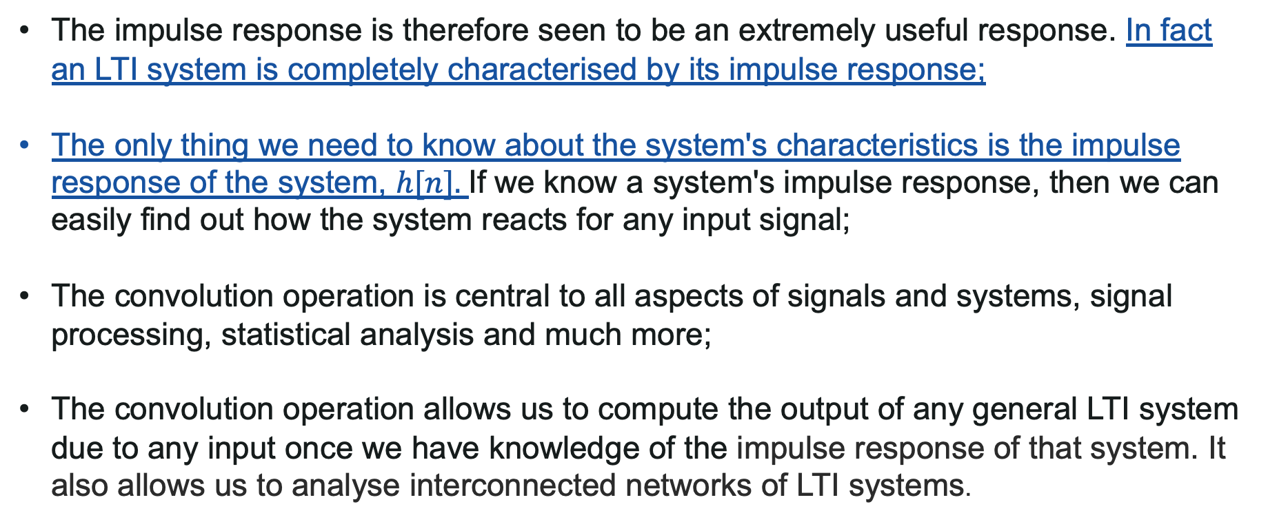
Convolution sum - remarks
The impulse response is therefore seen to be an extremely useful response. In fact an LTI system is completely characterised by its impulse response;
The only thing we need to know about the system's characteristics is the impulse response of the system, $h[n].$If we know a system's impulse response, then we can easily find out how the system reacts for any input signal;
The convolution operation is central to all aspects of signals and systems, signal processing, statistical analysis and much more;
The convolution operation allows us to compute the output of any general LTI system due to any input once we have knowledge of the impulse response of that system. It also allows us to analyse interconnected networks of LTI systems.

Slide 34
Convolution sum - Properties
Commutative
$$x[n]$$
$$y[n]$$
$$h[n]$$
x[n]
$$y[n]$$
h[n]
Is equivalent to

Slide 35
Convolution sum - Properties
Associative
Useful in series connected networks
$$x[n]$$
$$y[n]$$
$$h_{1}[n]$$
$$h_{2}[n]$$
Is equivalent to
$$x[n]$$
$$y[n]$$
$$h_{1}\left[n\right]∗h_{2}[n]$$

Slide 36
Convolution sum - Properties
Distributive
Useful in parallel connected networks
$$h_{1}[n]$$
$$x[n]$$
$$y[n]$$
$$x[n]$$
$$y[n]$$
Is equivalent to
$$h_{1}\left[n\right]+h_{2}[n]$$
$$h_{2}[n]$$

Slide 37
Convolution sum - Properties
Shift
If
$y[n] = x[n] ∗ h[n]$
then
$$y[n−n0] = x[n−n0] ∗ h[n] = x[n] ∗ h[n−n0]$$

Slide 38

Computing the convolution
We want to find a way to compute simply by hand convolutions of short sequences;
A Toeplitz matrix is a matrix whose diagonal is constant, such as

Slide 39
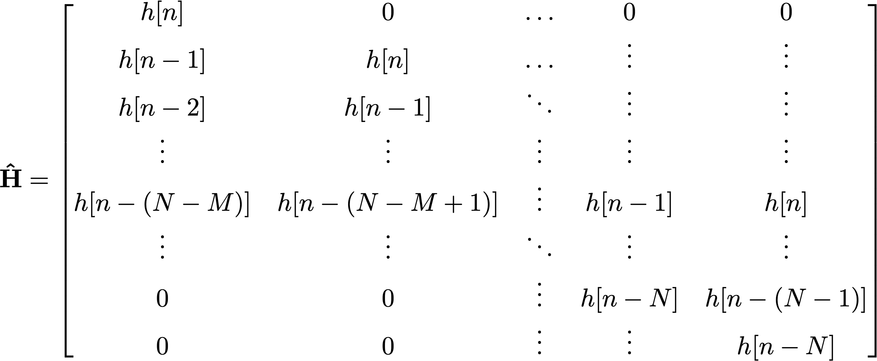
Computing the convolution
If we define:
$N$ is the length of $h[n]$, $M$ is the length of $x[n]$

Slide 40
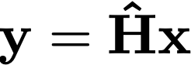
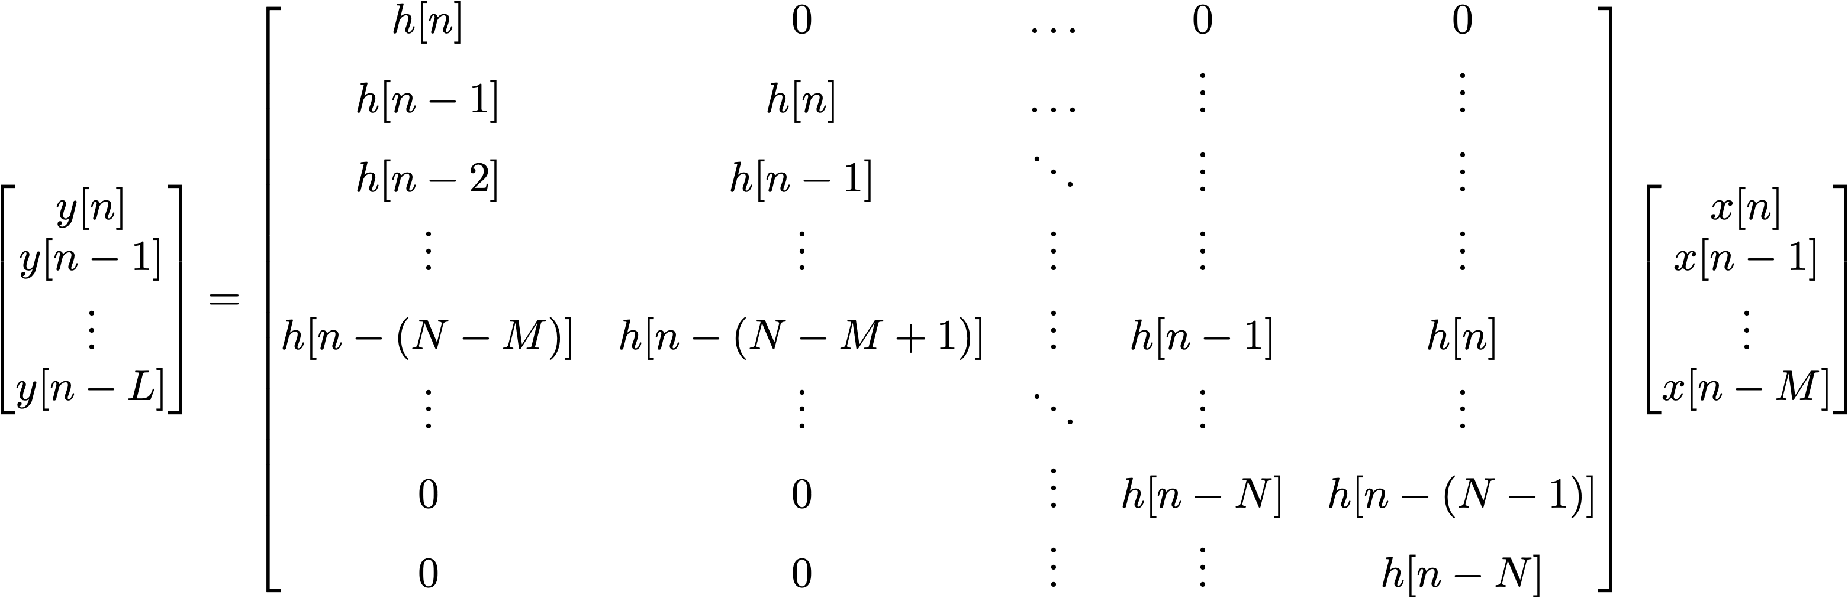
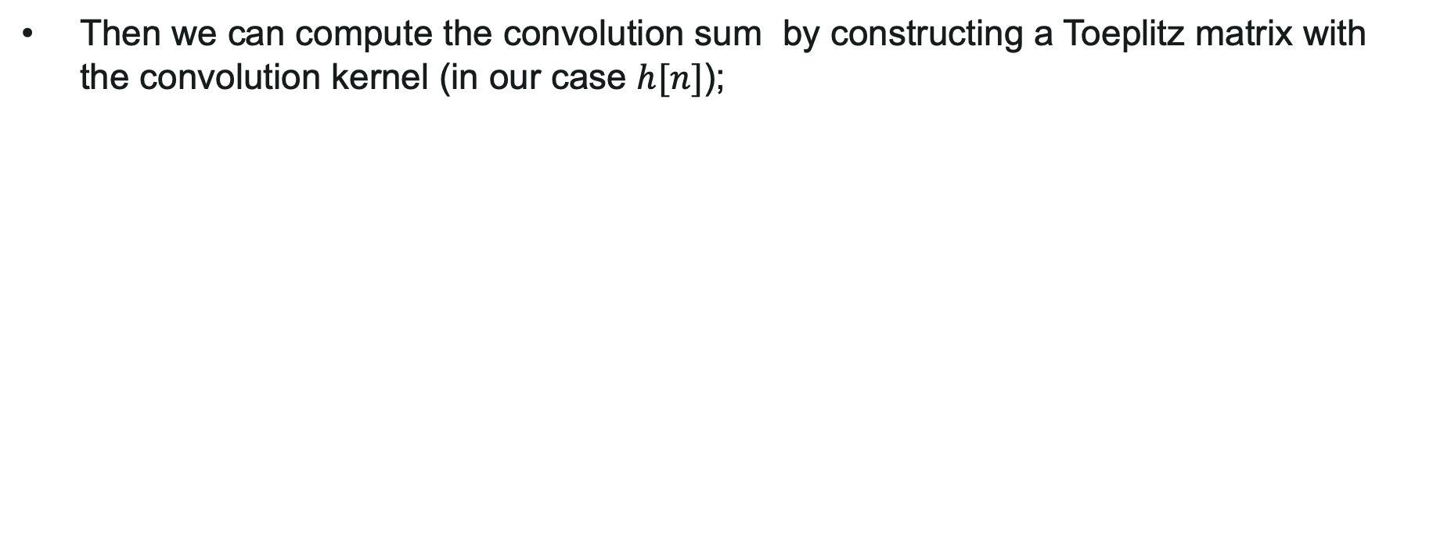
Computing the convolution
Then we can compute the convolution sum by constructing a Toeplitz matrix with the convolution kernel (in our case $h[n]$);
With $L = N+M −1$

Slide 41
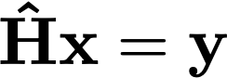
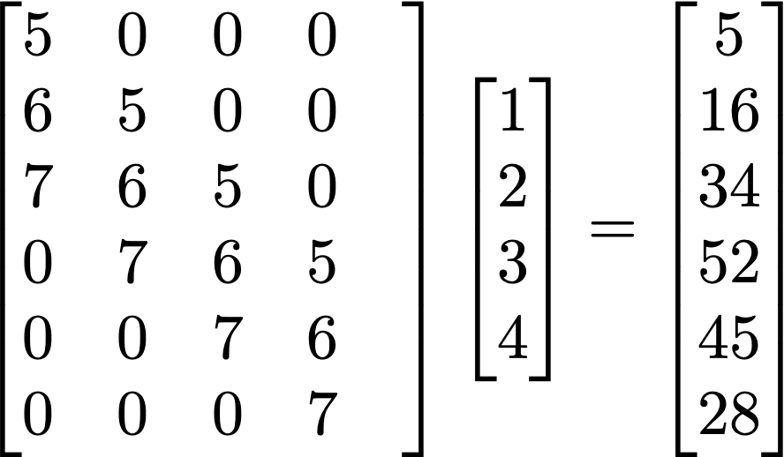
Computing the convolution
For $x[n]=[1 2 3 4] h[n]=[5 6 7]$use the Matrix Method to show
$$y[n]=x[n]∗h[n]=h[n]∗x[n]=[ 5 16 34 52 45 28 ]$$

Slide 42
Convolution exercises
Ex 1: Two systems connected in cascade with impulse responses $f[n]=[1 2 3]$, $g[n]=[4 5 6 7]$. Find the overall impulse response of the network.
Ex 2: Three systems connected in cascade with impulse responses $e[n]=[1 −1]$, $f[n]=[1 0 1$] , $g[n]=[1 1].$Show that the overall impulse response of this network is $h[n] = [ 1 0 0 0 −1].$
If the input to this system is a sampled 50Hz cosine with sampling frequency of 200Hz find the output . Use at least 3 periods of the sampled signal.
Ex 3: Given $x[n]= cos⁡(πn/2)$and $h[n]= δ[n]− δ [n−4]$use convolution sum to show that $y[n]=x[n]∗h[n] = 0$.
Ex 4: If $h[n]=(0.5)n u[n]$ and $x[n]=u[n$] Find and sketch $y[n]=r[n]=h[n]∗x[n]$
Using$r[n]$find the output if $x[n]= u[n]−u[n−6]$find the output
Ex 5: Given $x[n] = [ 1 4 1 10 14 16 2 1 16 15 18 1 0 1 ]$, $h1[n]=[ 1 2 1 ]$A smoothing filter) and $h2[n] = [1 −1]$(a difference filter) use the matrix method to compute (i) $y1[n]=x[n]∗h1[n]$(ii) $y2[n]=x[n]∗h2[n]$. You can check your answers using Matlab.

Slide 43
2D Convolution
2D convolution is just extension of 1D convolution by convolving both horizontal and vertical directions in the 2 dimensional spatial domain.
Convolution is frequently used for image processing, such as smoothing, sharpening, and edge detection of images and is of fundamental importance in Deep Learning Convolution Neural Networks (CNNs).
The discrete impulse (delta) function is also in 2D space, so $δ[m,n]$has 1 when m and n are zero and zeros when $m,n ≠ 0$. The impulse response in 2D is usually called "kernel" or "filter" in image processing.

Slide 44
2D Convolution – 2D impulse

Slide 45
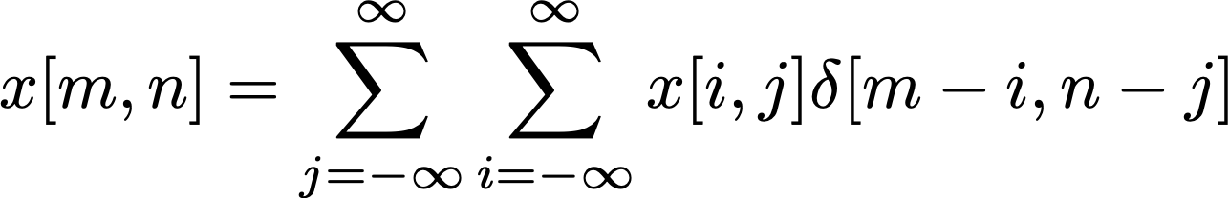
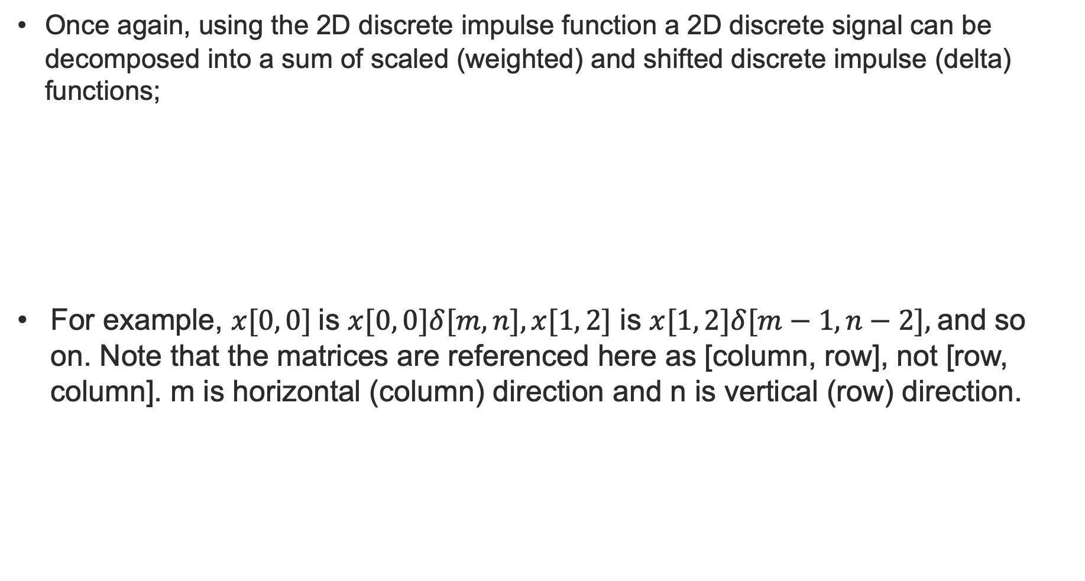
2D Convolution
Once again, using the 2D discrete impulse function a 2D discrete signal can be decomposed into a sum of scaled (weighted) and shifted discrete impulse (delta) functions;
For example, $x[0, 0]$is $x[0, 0]δ[m, n], x[1, 2]$ is $x[1, 2]δ[m−1, n−2],$and so on. Note that the matrices are referenced here as [column, row], not [row, column]. m is horizontal (column) direction and n is vertical (row) direction.

Slide 46
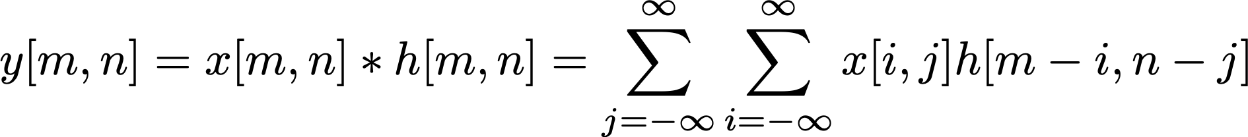
2D Convolution
And, the output of the linear and time invariant (LTI) 2D system can be written by 2D Linear convolution sum (the core computational element in deep convolutional neural networks) of the input signal $x[m, n],$and impulse response, $h[m, n]:$
Kernel Matrix

Slide 47
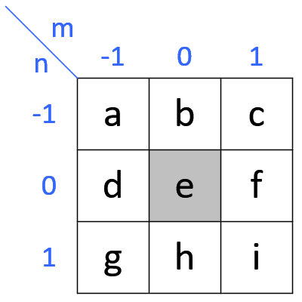
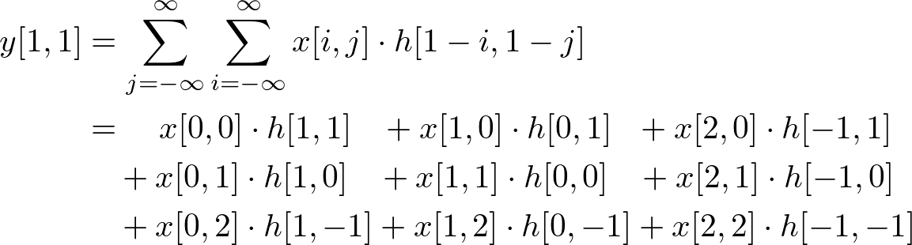
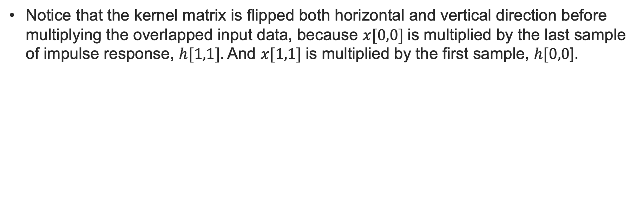
2D Convolution Sum
Notice that the kernel matrix is flipped both horizontal and vertical direction before multiplying the overlapped input data, because $x[0,0]$is multiplied by the last sample of impulse response, $h[1,1].$And $x[1,1]$is multiplied by the first sample, $h[0,0$].

Slide 48
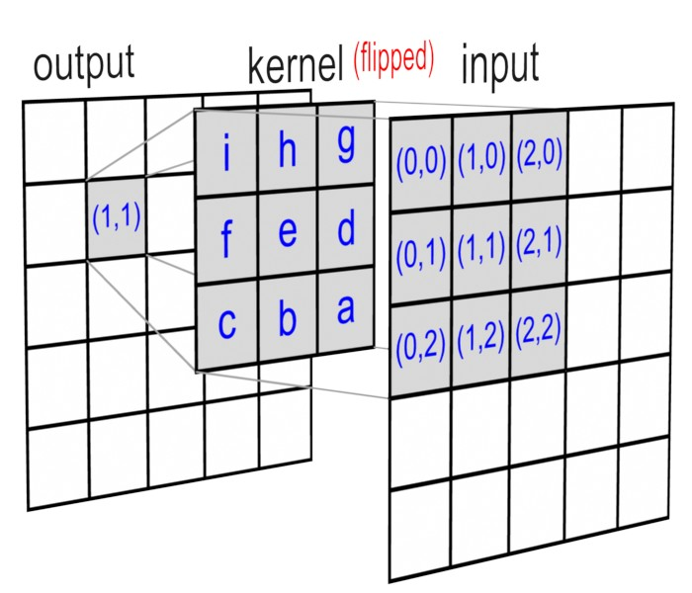
2D Convolution Sum: Graphical Illustration

Slide 49
2D Convolution Sum Using Separable Filters
In 2D convolution with an $M×N$ kernel, requires $M×N$ multiplications for each sample;
For example, if the kernel size is $3x3$, then, 9 multiplications and accumulations are necessary for each sample;
Thus, 2D convolution is very computationally expensive to perform the necessary multiply and accumulate operations;
However, if the kernel is separable, then the computation can be reduced to $M + N$multiplications per sample.

Slide 50
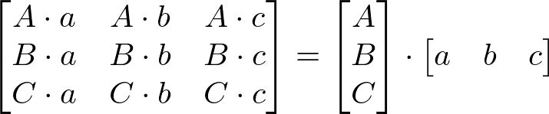
2D Convolution Sum Using Separable Filters
A matrix is separable if it can be decomposed into $(M×1)$and $(1×N)$matrices.
For Example:
And hence 2D convolution with this separable kernel is equivalent to:
Rows convolved
Columns convolved

Slide 51
2D Convolution Sum Using Separable Filters
Therefore in order to reduce the computation, we perform 1D convolution twice instead of 2D convolution.
This involves a convolution with the input and M×1 kernel in vertical direction, then a convolution in the horizontal direction with the result from the previous convolution and the 1×N kernel.
The first vertical 1D convolution requires M times of multiplications and the horizontal convolution needs N times of multiplications, altogether, M+N products.
However, the separable 2D convolution requires additional storage (buffer) to keep intermediate computations. That is, performing a vertical 1D convolution first, the first stage results must be preserved in a temporary buffer in order to use them for horizontal convolution subsequently.

Slide 52
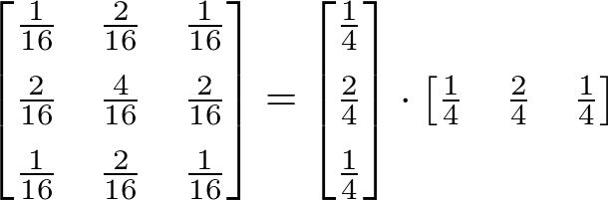
2D Convolution Sum Using Separable Filters – Gaussian Filter
Notice that convolution is associative; the result is same, even if the order of convolution is changed.
Therefore convolution in the horizontal direction first then vertical direction later is equivalent to convolution in the vertical direction first then horizontal direction later.
As an example consider the Gaussian filter that is commonly used for smoothing. This is a well-known separable matrix. For example, 3x3 Gaussian filter is:

Slide 53


Sobel Edge Detector
A second example is the 3x3 Sobel filter used for edge detection that uses a combination of smoothing and differentiation kernel (2D impulse response) as seen in the following
This is a 3x3 impulse response (kernel) to detect horizontal edges
This is a 3x3 impulse response (kernel) to detect vertical edges
3x3 Sobel Kernels (Impulse response)
Thus for an image $I, Ix = I ∗ S$_{hor} and $Iy= I ∗ Sver$are the processed images in the horizontal and vertical directions respectively and the resulting edge detected image is computed as:

Slide 54

Exercise
Use pen and paper to filter the following 5x5 image $I$ using a 3x3 Sobel Edge detector to produce an output $Iout$. You may assume that the elements outside the borders of$I$equals 0. In your answer the dimension of the processed image $Iout$ should remain of size 5x5

Slide 55
Correlation
Examples:
In digital communications a set of data symbols may be represented by a set of unique discrete time sequences. If one of these time sequences is transmitted the receiver has to determine which particular sequence has been received by comparing the received signal with every member of possible sequences from the set.
Similarly in radar and sonar applications the received signal reflected from a target is the delayed version of the transmitted signal and by measuring the delay one can determine the location of the target.
Correlation is the process of comparing two signals. The level of comparison at different relative lags is measured by the computed correlation coefficient.

Slide 56


Linear Correlation
Correlation lag
Correlation index
If $h[n] = x[n]$then we obtain $R_{xx}[j$], called autocorrelation function
Note: $R_{xx}\left[0\right]$ is the Energy of $x\left[n\right]$!

Slide 57
Normalised Correlation Coefficients
For comparing and displaying correlation coefficients it is normal to use normalised forms of the autocorrelation and cross correlation coefficients defined as :
A normalised coefficient of
1 implies 100% similarity between the two signals
-1 implies maximum 100% opposite type signals (when one increases the other decreases)
0 implies NO correlation between the two signals

Slide 58



Computing the correlation
Also in this case we can use matrix multiplication to compute the correlation, but we need to modify one of the two matrices:
Lags
-3
-2
-1
0
1
2
Flip left right of
Correlation is not commutative

Slide 59
Example with shift method

Slide 60

Excercise
For the previous case compute
$R_{xx}[j]$, what is the energy of x[n]?
$R_{hh}\left[j\right],$ what is the energy of h[n]?
$η_{xh}[j],η_{xx}[j],$ $η_{hh}[j]$
Compute the Energy, and the Normalised Autocorrelation Lags for the following 2 Discrete signals.
x₁[n]=[-4 -4 -1 3 5 1 0 -3]
x₂[n]=[5 0 -2 2 3 2 5 -2]
From your results (plot them) deduce with reasons which signal has a periodic component and which signal is of a random nature. (hint. there is one of each!)

Slide 61



Cyclic Convolution/Correlation
If $x[n]$ and $h[n]$ are periodic with periods $M$ and $L$ respectively then the linear convolution/correlation sum of $x[n]$ with $h[n]$ cannot be computed as the signals exist for all time and therefore the summations will not converge.
In this case we define the cyclic (periodic) convolution/correlation over a common period.
The cyclic convolution/correlation are what are produced when the DFT is used to compute the convolution/correlation (more in the coming lectures). Therefore it is an important concept to understand and we will return to this later.
Cyclic Convolution
Cyclic Correlation

Slide 62
Block Convolution-overlap method
Block Convolution is the situation where a long sequence is convolved with a much shorter length sequence;
For example consider a receiver receiving an incoming signal which may be considered as infinite;
Furthermore in order to de-noise the signal it sometimes needs to be filtered with an FIR (Finite Impulse Response) filter of length M (where M << length of incoming signal);
There are two general methods to this problem named Overlap Add and Overlap Save Methods collectively called Block Convolution methods;
When combined with the efficient FFT these methods are called the Fast Convolution Methods.

Slide 63

Block Convolution-Overlap Save
Problem: A signal $x[n]$is to be linearly convolved with a digital filter with impulse response $h[n]$ of length $M$.
The overlap-save procedure divides the signal into equal length segments ($L$) with some overlap $(M−1)$.
$L−M$ zeros are appended to $h[n]$ to form $h’[n]$, a length $L$ signal.
The cyclic convolutions between each segment and $h’[n]$are computed saving only the valid parts of the cyclic convolution (discarding $M−1$ outputs from each cyclic convolution.
Each resulting output segment of valid samples $(L−M+1)$values, are concatenated to produce the output Linear Convolution between $x[n]$and $h[n].$In order for the output to produce the exact Linear Convolution the first segment needs to be prepended with $M−1$ zeros.

Slide 64
Block Convolution-Overlap Save
L
L
L
x[n]
h[n]
M
M-1
M-1
Process Block
by cyclic convolution L length with M (appended with zeros to length L)
Output results and discard 1st M-1 samples
Process Block
by cyclic convolution L length with M (appended with zeros to length L)
Output results and discard 1st M-1 samples
Process Block
by cyclic convolution L length with M (appended with zeros to length L)
Output results and discard 1st M-1 samples
output
L-M+1
L-M+1
L-M+1

Slide 65

Block Convolution-Overlap Add
Problem: A signal $x[n]$ is to be linearly convolved with a digital filter with impulse response $h[n]$ of length $M$.
The overlap-add procedure divides the signal into equal length segments of length ($L$) with no overlap.
Then each segment is zero padded with $(M−1)$zeros to make each appended block $N= L+M−1$length.
$N−M$ zeros are appended to $h[n]$ to form $h’[n]$, a length $N$ signal.
The cyclic convolutions between each segment and $h’[n]$are computed.
The beginning section of length $M−1$ samples from each segment are added to the adjoining end ($M−1$ samples) of the previous segment. In order for the output to produce the exact Linear Convolution the first segment needs to be prepended with $M−1$ zeros.

Slide 66
Block Convolution-Overlap Add
L
L
L
x[n]
h[n]
M
Process Block
Append zeros onto both signal to length N such that N = L+M -1
Perform cyclic conv
Output results and overlap by M-1 on previous output and add corresponding outputs
Process Block
Append zeros onto both signal to length N such that N = L+P -1
Perform cyclic conv
Output results and overlap by P-1 on previous output and add corresponding outputs
Process Block
Append zeros onto both signal to length N such that N = L+M -1
Perform cyclic conv
Output results and overlap by M-1 on previous output and add corresponding outputs
Process Block
Append zeros onto both signal to length N such that N = L+M -1
Perform cyclic conv
Output results and overlap by M-1 on previous output and add corresponding outputs
N
+
N
M-1
+
M-1

Slide 67
X THE PLACE OF USEFUL LEARNING

